Slide 1
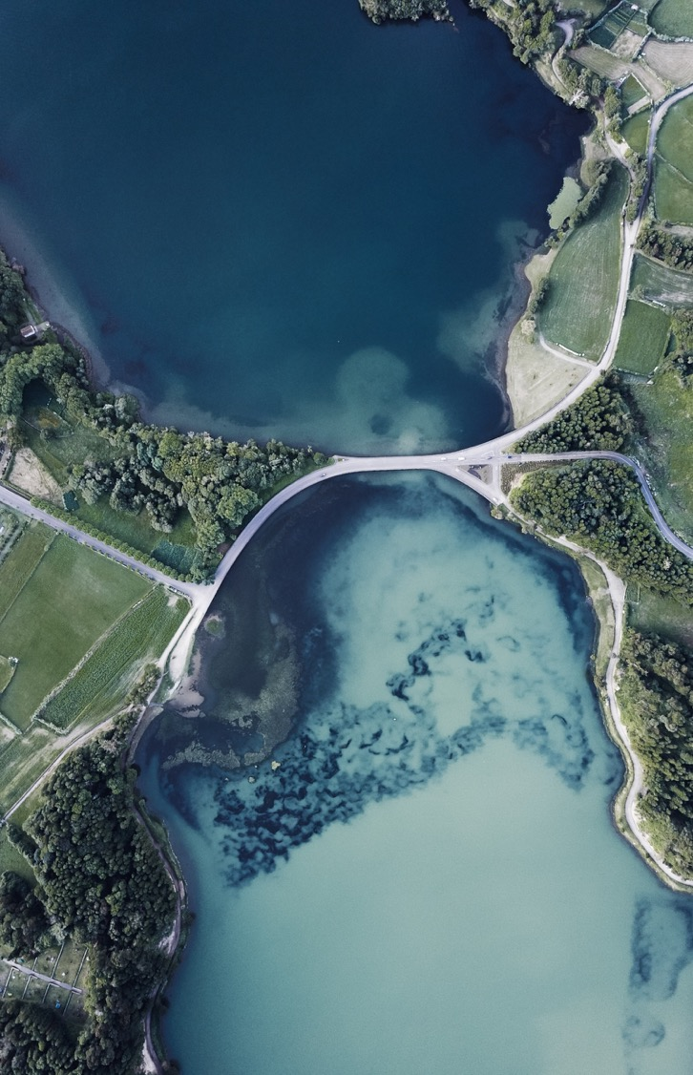

Water Quality Prediction using IoT-enabled soft-sensor
Author: Palok Biswas
Contact: palok@digitalforest.io

Slide 2
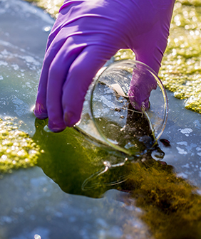
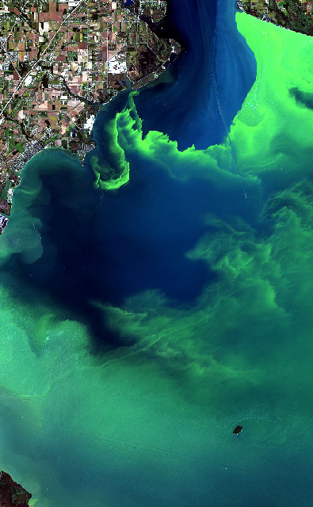
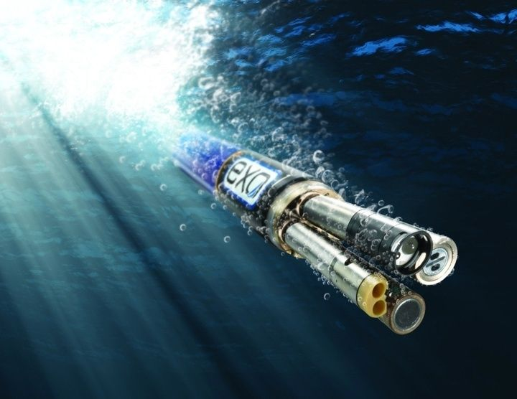
Background
About 60% of Malaysian lakes suffer from eutrophication
Eutrophication or algal bloom is caused by excessive organic nutrients (a by product of human activities)
Currently, water sampling is done manually, involving expedition with boats
In-situ measurement by dipping hand-held sonde into water is preferred
Common 5 parameters measured in-situ include pH, temperature, conductivity, turbidity and dissolved oxygen
For eutrophication, usually test in the lab is required to measure Chlorophyll-a content.
Grab Sampling
Algal Bloom
YSI EXO Sonde

Slide 3
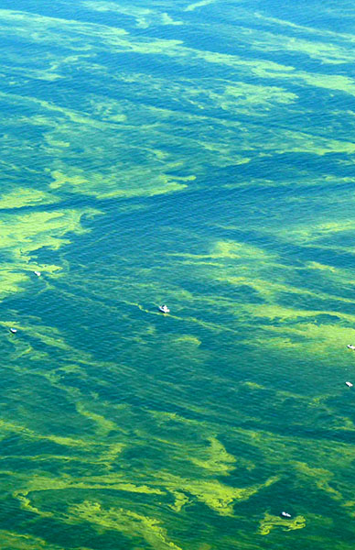
Problem statement
Industrial grade in-situ water quality sondes are very expensive and usually not IoT-enabled.
Collecting high resolution spatiotemporal water quality data continuously (involving multiple sensors) with industrial sondes is not economically feasible.
In-situ sampling is preferred for continuous real-time monitoring of water quality but there is no cost-effective sensor for chlorophyll-a.

Slide 4
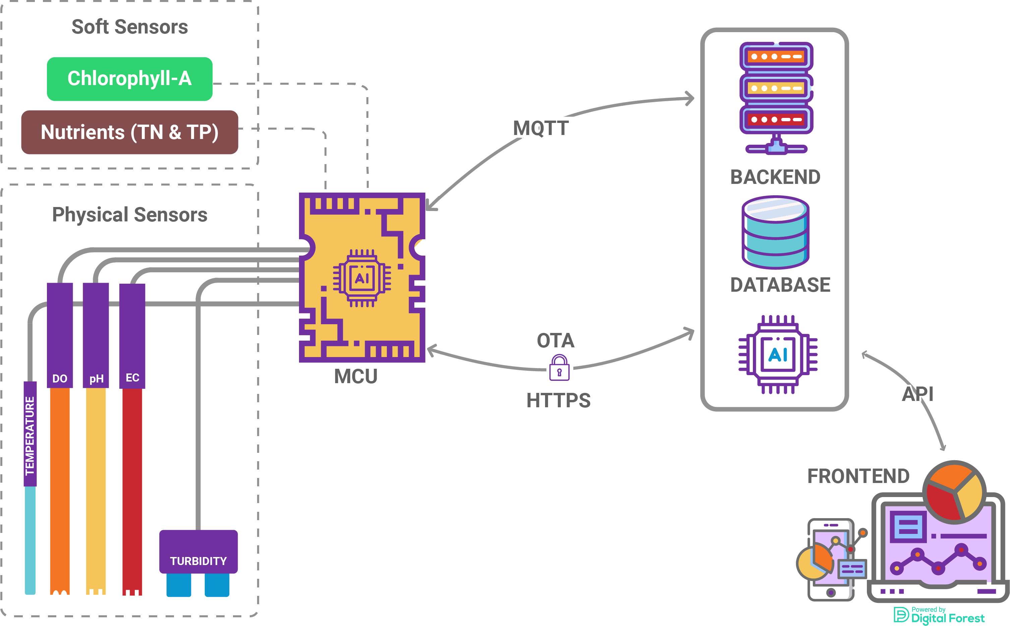
Solution architecture
Low cost physical sensors of Temperature, Dissolved Oxygen, pH, Electrical Conductivity & Turbidity
Chlorophyll-A and Nutrients Soft-sensor using edge inferencing.
Edge device with IoT features including Over the Air Firmware Update.
Cloud for storing and processing IoT data, continuous training of ML model, IoT fleet management & dashboard for visualization

Slide 5
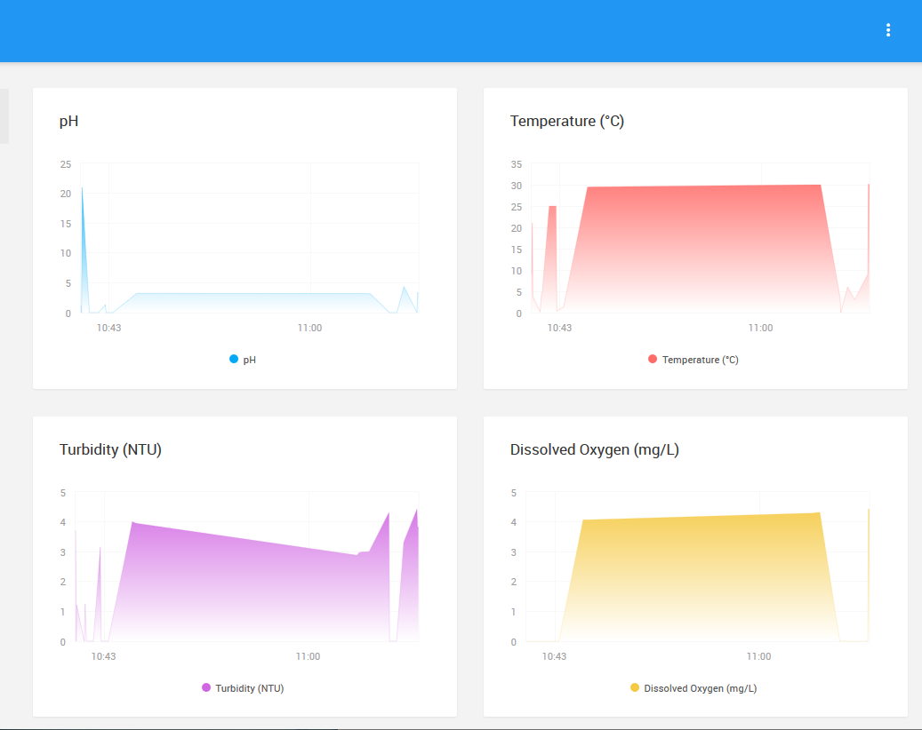
DATA VISUALIZATION on frontend

